Slide 1
Post-Punk
into the early 1980s

Slide 2
The Clash, 1976-1986
Joe Strummer (vocals, rhythm guitar)
Mick Jones (lead guitar, vocals)
Paul Simonon (bass guitar, vocals)
Nicky "Topper" Headon (drums)
Bernard Rhodes (manager, organizer, image-director), “An issue, an issue!”
Sex Pistols were crucial.
Joe Strummer: “The Pistols came out that Tuesday evening and their attitude was ‘Here's our tunes, and we couldn't give a flying fuck whether you like them or not. In fact, we're gonna play them even if you fucking hate them.’ They were a really firing live unit.”
Notes:
Source: Joe Strummer, “Ex-Clash Singer Breaks Ground”, accessed 9 December 2015: http://www.joestrummer.us/rc00/

Slide 3
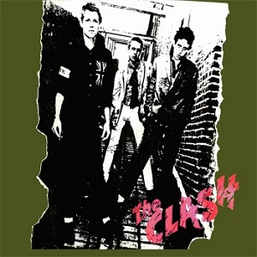
The Clash, 1976-1986
First performance: 4 July 1976, opened for the Pistols.
January 1977: signed contract with CBS: 100,000 GBP
Many cried sell out. Sniffin’ glue: “Punk died the day the Clash signed to CBS.”
Strummer said:
“[S]igning that contract did bother me a lot. I've been turning it over in my mind, but now I've come to terms with it. I've realised that all it boils down to is perhaps two-year's security ... Before, all I could think about was my stomach ... Now I feel free to think—and free to write down what I'm thinking about ... And look—I've been fucked about for so long I'm not going to suddenly turn into Rod Stewart just because I get £25.00 a week. I'm much too far gone for that, I tell you.”
First hit, “White Riot,” (released March 1977), reached no. 34.
First album, The Clash (April 1977)
CBS did not want to release it in USA
But sold massively as import.
Notes:
Caroline Coon, The New Wave Punk Rock Explosion (New York: Hawthorn, 1988).

Slide 4

The Clash, 1976-1986
Openly political band, especially Strummer.
Liege concert (August 1977) tried to pull down barbed wire.
Insisted on keeping album prices low.
Often performed for free and charity.

Slide 5
The Slits, 1976-82
Ari Up (Ariane Forster) - vocals
Palmolive (a.k.a. Paloma Romero) - drums
Viv Albertine - guitarist
Tessa Pollitt - bass guitarist
More punk than punk rock
Reggae influenced as well:
“Typical Girls”: https://www.youtube.com/watch?v=QCk8tEOcwqU
“Heard it through the Grapevine”: https://www.youtube.com/watch?v=pSq3-lE377Q

Slide 6
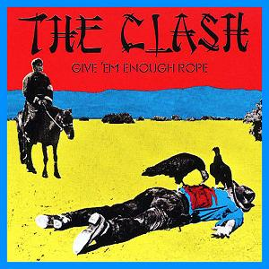
The Clash, 1976-1986
Second album, Give 'Em Enough Rope, (November 1978)
“Tommy Gun”: https://www.youtube.com/watch?v=bFHEuKkTa5k

Slide 7
The Clash, 1976-1986
Third, defining album, London Calling (December 1979)
Considered the post-punk statement
Incorporated many genres: punk, ska, pub rock, rockabilly, reggae, R&B, New Orleans pop, and experimentation.
Most songs strikingly political.
“London Calling”
“Koka Kola”: https://www.youtube.com/watch?v=AXphJS1HQmc
“Death or Glory”: https://www.youtube.com/watch?v=2NRSQBSZdKI

Slide 8
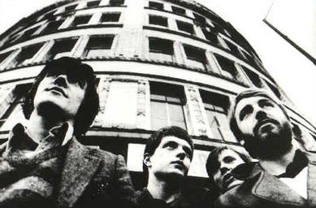
Joy Division, 1976-1980
Salford, Manchester, working class boys
Met at Sex Pistols concert
Ian Curtis (vocals)
Bernard Sumner (guitar, keyboards)
Peter Hook (bass)
Stephen Morris (drums)
Original name, “Stiff Kittens,” then “Warsaw.”
Tony Wilson signed them to his record company, Factory Records.

Slide 9
Joy Division, 1976-1980
First Album, Unknown Pleasures (1979)
“She’s Lost Control”: https://www.youtube.com/watch?v=xd0bH8EmdlQ
Second Album: Closer (1980)
“Transmission”: https://www.youtube.com/watch?v=Ou-hvgEb-BU
Curtis committed suicide, 18 May 1980
Post-humously released “Love will tear us apart”: https://www.youtube.com/watch?v=I-2i2SR_OsU
First chart hit, reaching no. 13 in UK, and no. 1 in New Zealand.
Led to New Order, formed from remaining members, later added Gillian Gilbert (keyboard and guitar).

Slide 10
California Post-Punk: Hardcore
X (formed 1977):
vocalist Exene Cervenka
vocalist/bassist John Doe
guitarist Billy Zoom
drummer D. J. Bonebrake
https://www.youtube.com/watch?v=ojBc4c1hX_4
Black Flag (formed 1976):
Founder: Greg Ginn (guitar, song-writer, etc)
Henry Rollins (1981-1986)
DIY punk ethic: SST Records
Hardcore punk
https://www.youtube.com/watch?v=Fsbvo5GVK10

Slide 11
The Dead Kennedys, 1978-1986
Formed 1978 in San Francisco, CA, USA
Original lineup:
Jello Biafra (Eric Reed Boucher) on vocals
East Bay Ray (Raymond Pepperell) on guitar
Klaus Flouride (Geoffrey Lyall) on bass
Ted (Bruce Slesinger) on drums
6025 (Carlos Cardona) on guitar, briefly
Record label: Alternative Tentacles
https://www.youtube.com/watch?v=eIqESwzCGg4

